Slide 1
Introduction to the Fundamentals of Data Science & Machine Learning
Welcome!

Slide 2
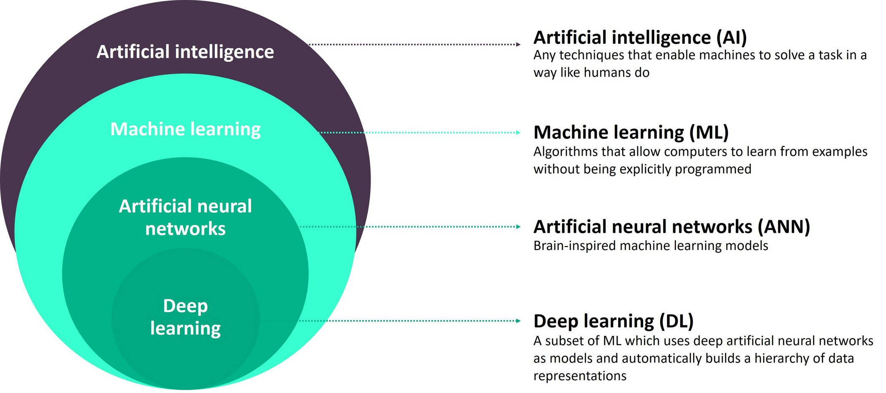

THE CONCEPT

Slide 3

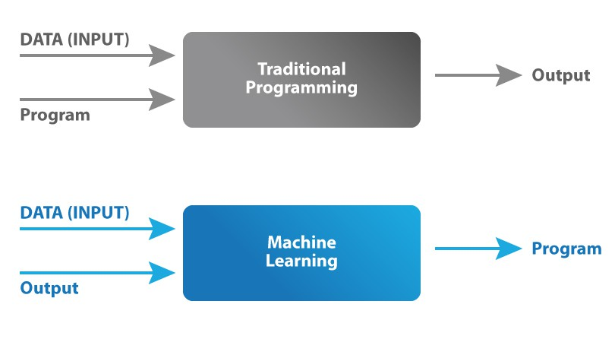
Traditional vs ML
TRADITIONAL VS ML

Slide 4
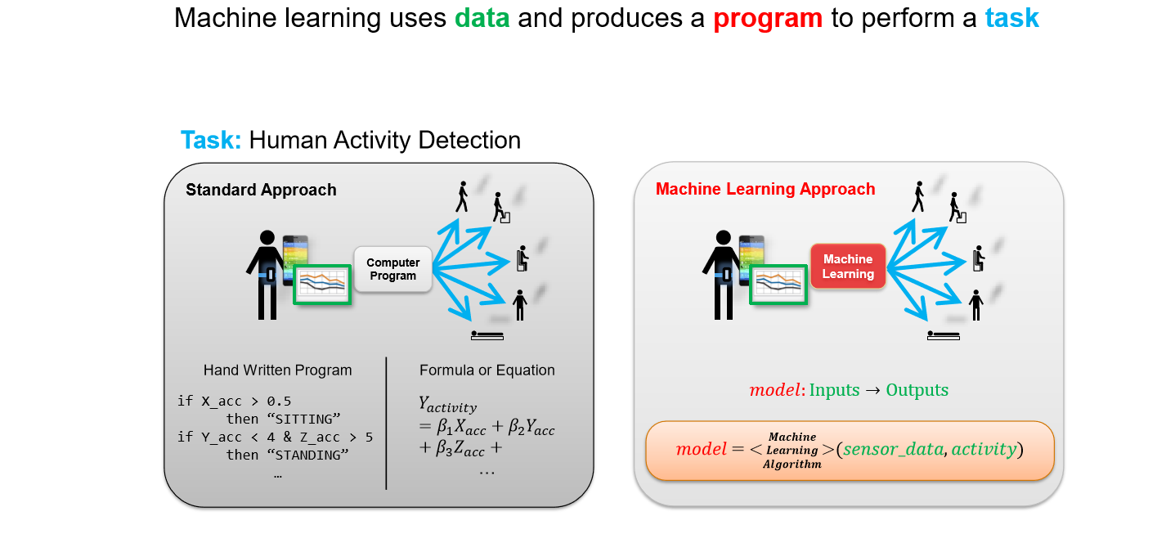
ML

Slide 5
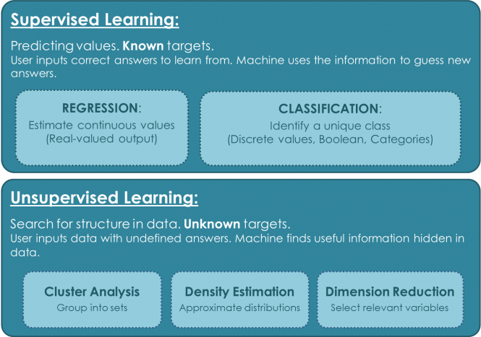
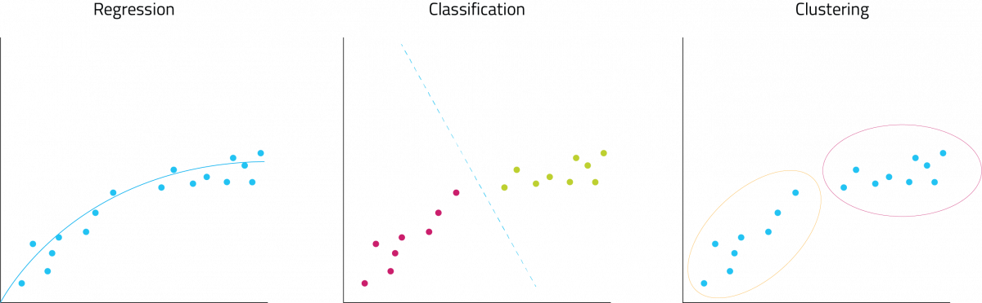
Classes of ML
Others: Reinforcement Learning, Generative AI

Slide 6

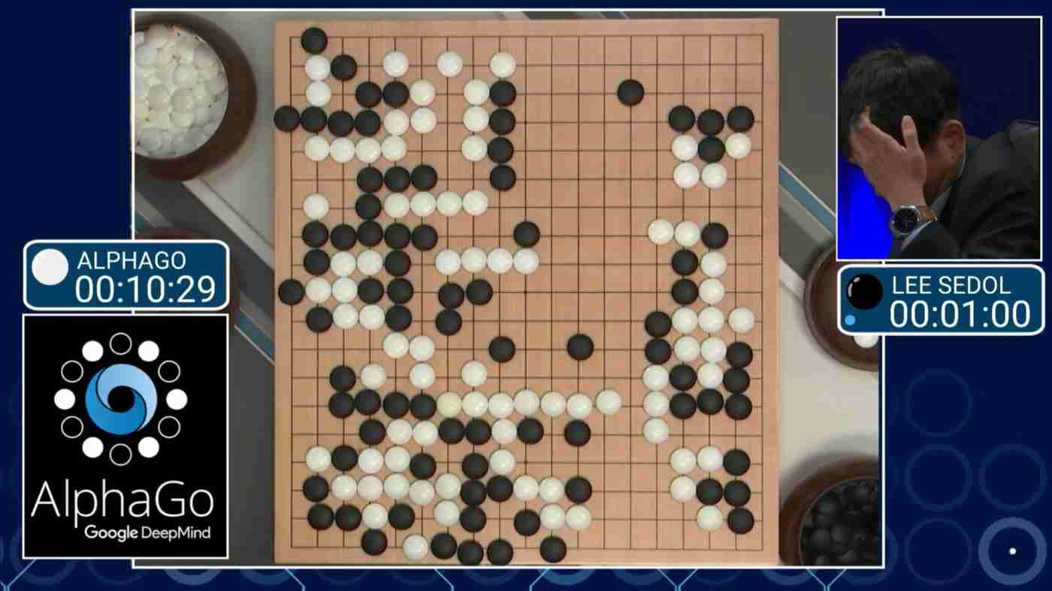
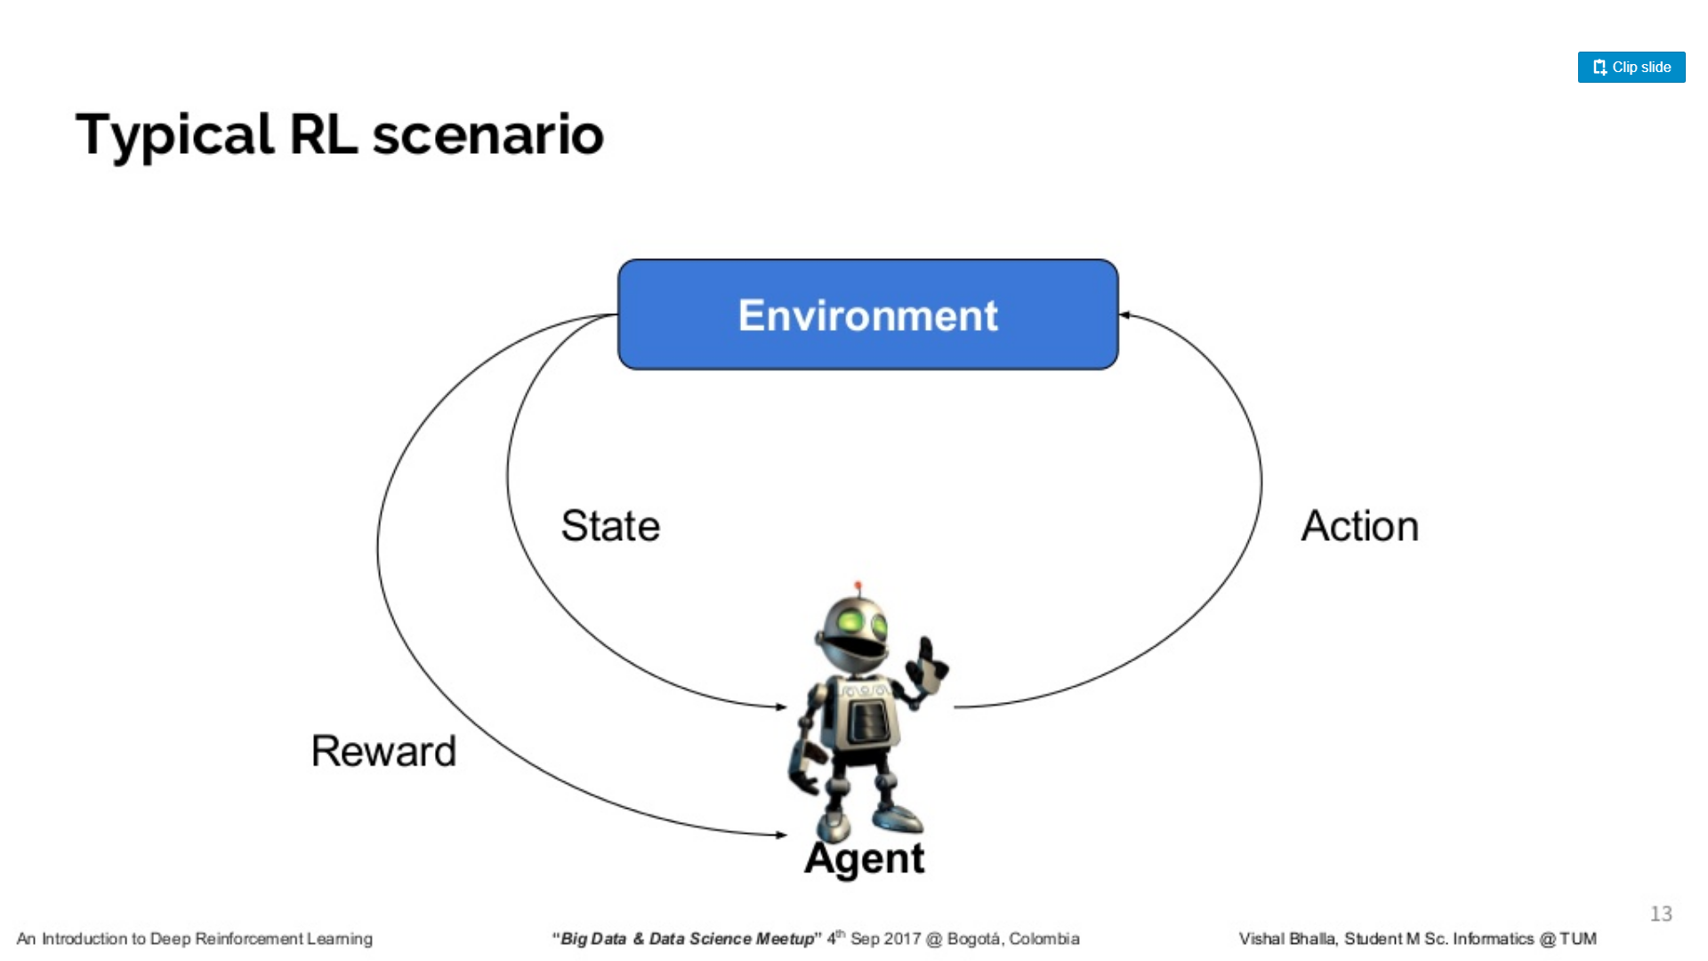
Reinforcement Learning
In the problem, an agent is supposed decide the best action to select based on his current state. When this step is repeated, the problem is known as a Markov Decision Process.

Slide 7
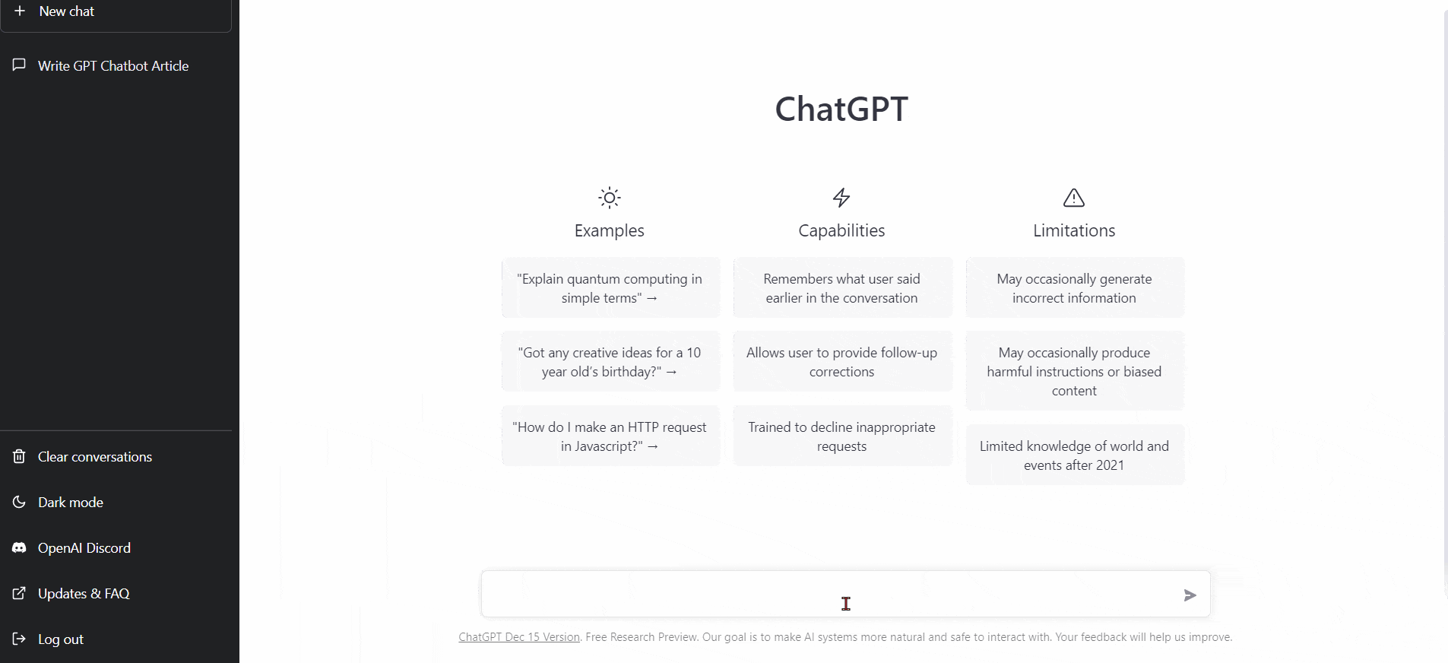
Generative AI

Slide 8

Generative AI Contd.

Slide 9
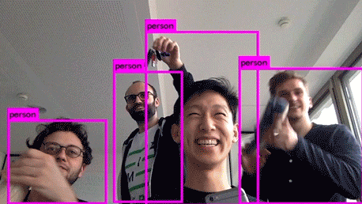
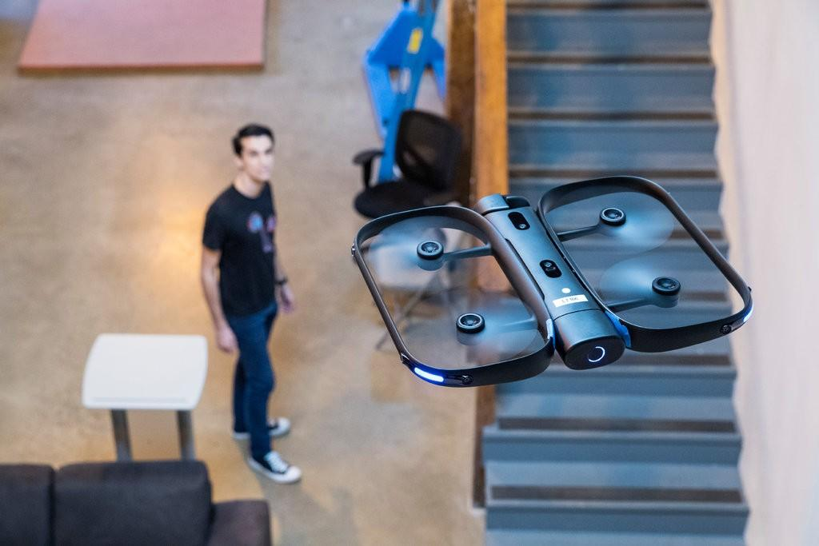
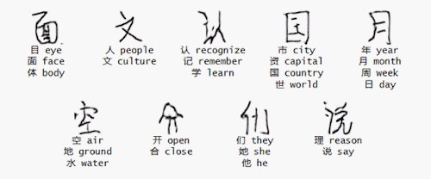
Application of Deep Learning
object detection
Real-time tracking
Generation of Language

Slide 10

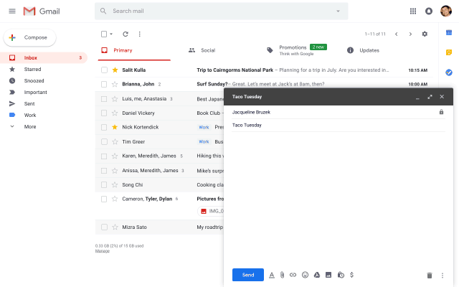
Smart Compose
Typical language generation models, such as ngram, neural bag-of-words (BoW) and RNN language(RNN-LM) models, learn to predict the next word conditioned on the prefix word sequence.

Slide 11

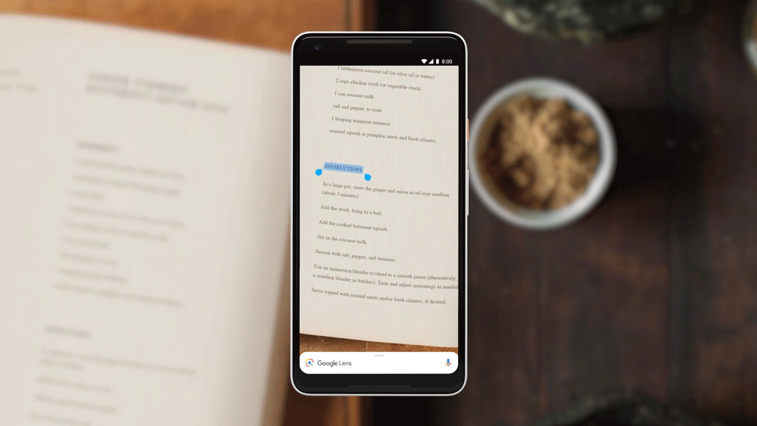
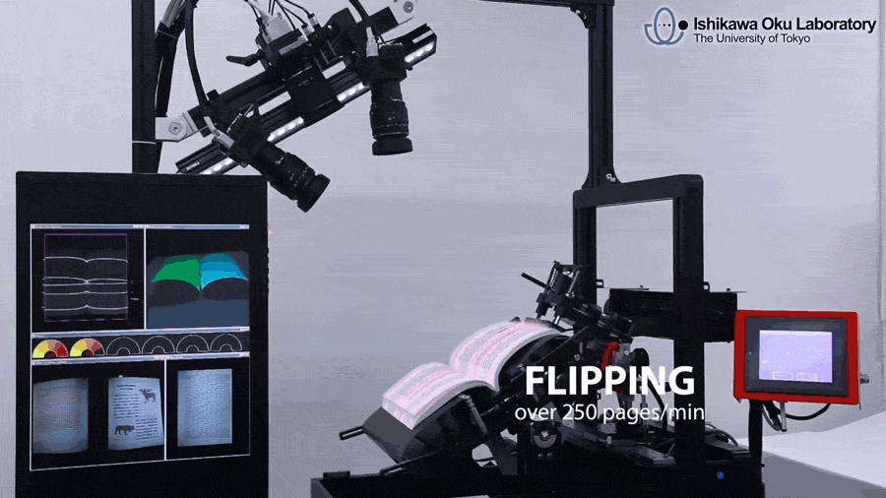
Google Len
Text Selection
Google leveraged on digitization of books around the world.

Slide 12
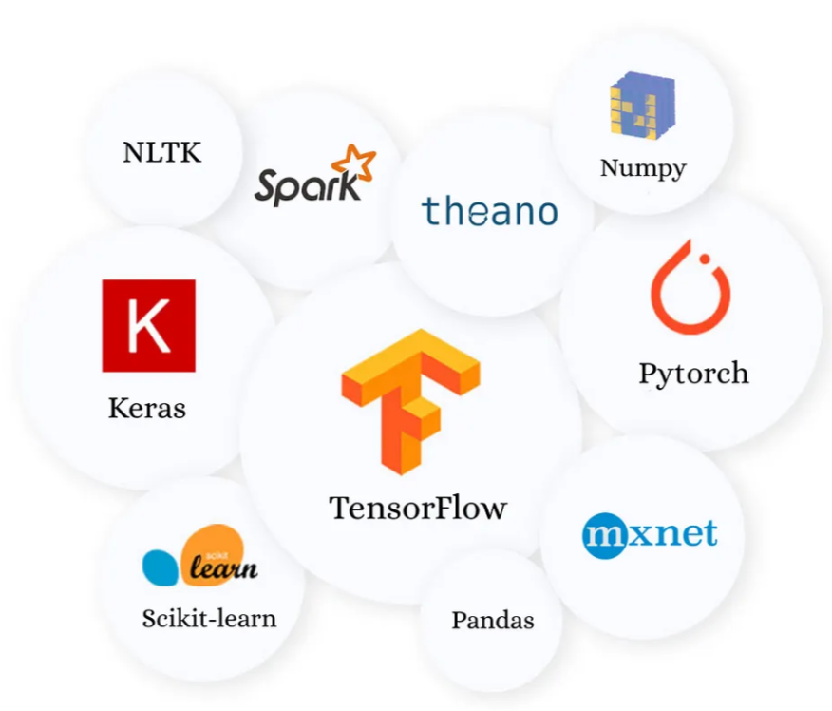
HOW TO GET STARTED

Slide 13
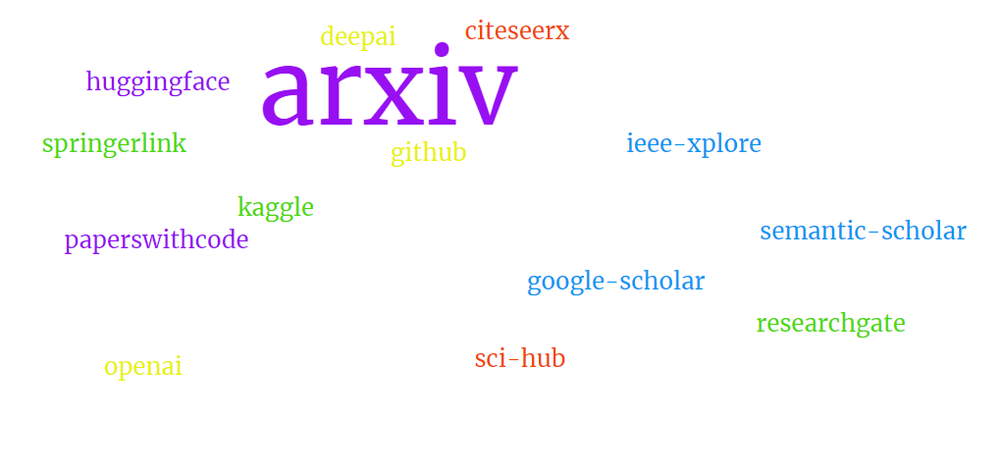
HOW TO GET STARTED Contd.

Slide 14
THANK YOU

